Slide 1

Canon as Emerging Meaning-Making Practice
Lore Whittemore, University of Colorado Boulder
tawh3581@colorado.edu

Slide 2
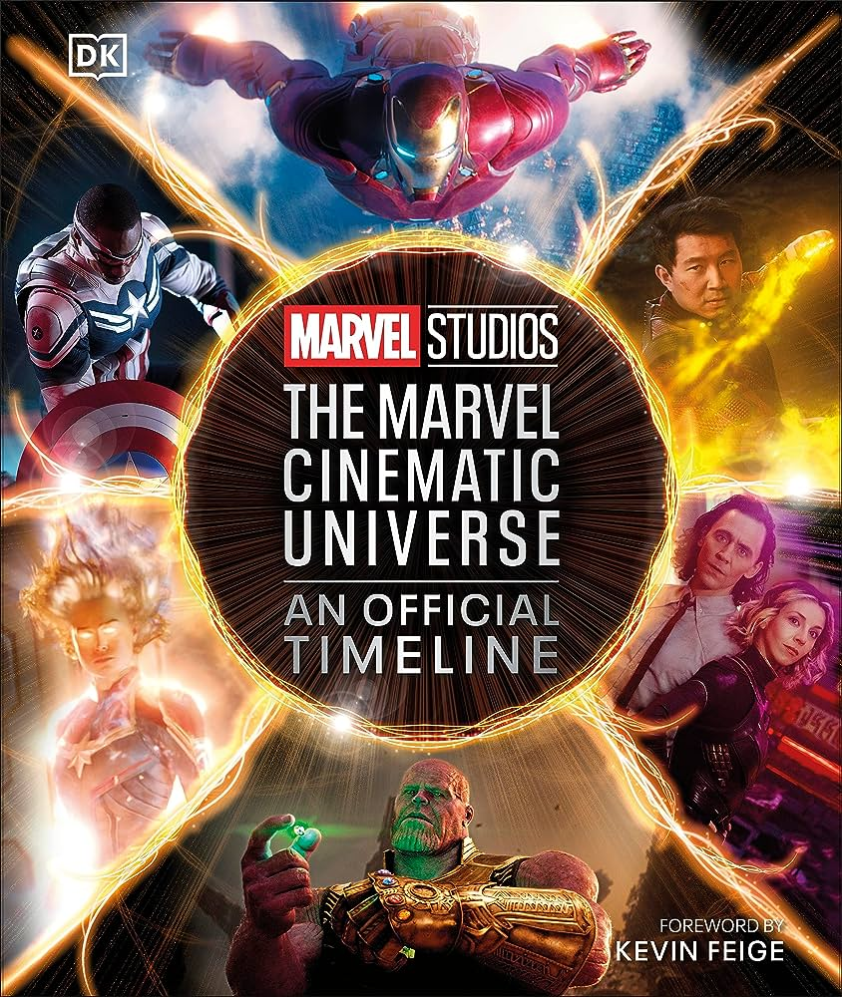
Kevin Feige and Canonicity
Foreword by Kevin Feige:
“On the Multiverse note, we recognize that there are stories—movies and series—that are canonical to Marvel but were created by different storytellers during different periods of Marvel’s history. The timeline presented in this book is specific to the MCU’s Sacred Timeline through Phase 4. But, as we move forward and dive deeper into the Multiverse Saga, you never know when timelines may just crash or converge (hint, hint / spoiler alert).” (2023, p. 7)”
Notes:
i. When Kevin Feige claims that movies and series produced by companies and subsidiaries outside of Marvel Studios are “canonical,” immediately disavows them from the “Sacred Timeline” or currently established continuity within the Marvel Cinematic Universe, and then indicates they may still have relevance to future developments—“you never know when timelines may just crash or converge (hint, hint / spoiler alert)”—the implicit question of narrative possibility becomes apparent (2023, p. 7)

Slide 3
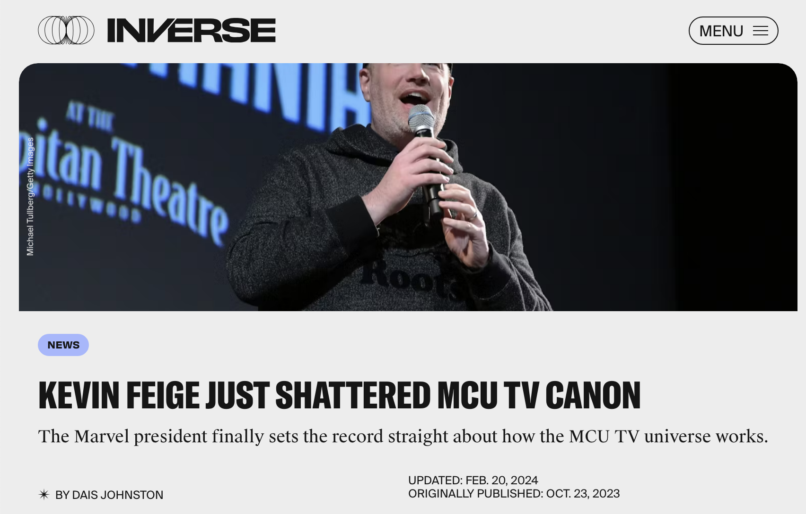
Responses
Image Source: Johnston, D. (2023, October 23). Kevin Feige Just Shattered MCU TV Canon. Inverse. https://www.inverse.com/entertainment/kevin-feige-marvel-tv-sacred-timeline-defenders-agents-of-shield-canon

Slide 4
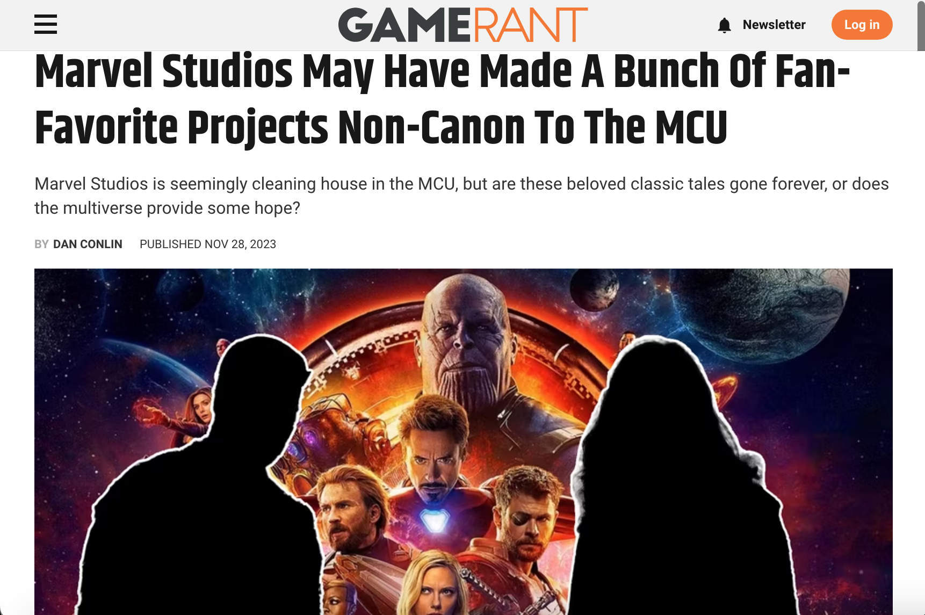
Responses
Image Source: Conlin, D. (2023, November 28). Marvel Studios May Have Made A Bunch Of Fan-Favorite Projects Non-Canon To The MCU. Game Rant. https://gamerant.com/daredevil-jessica-jones-mcu-timeline-canon-pushed-out/

Slide 5
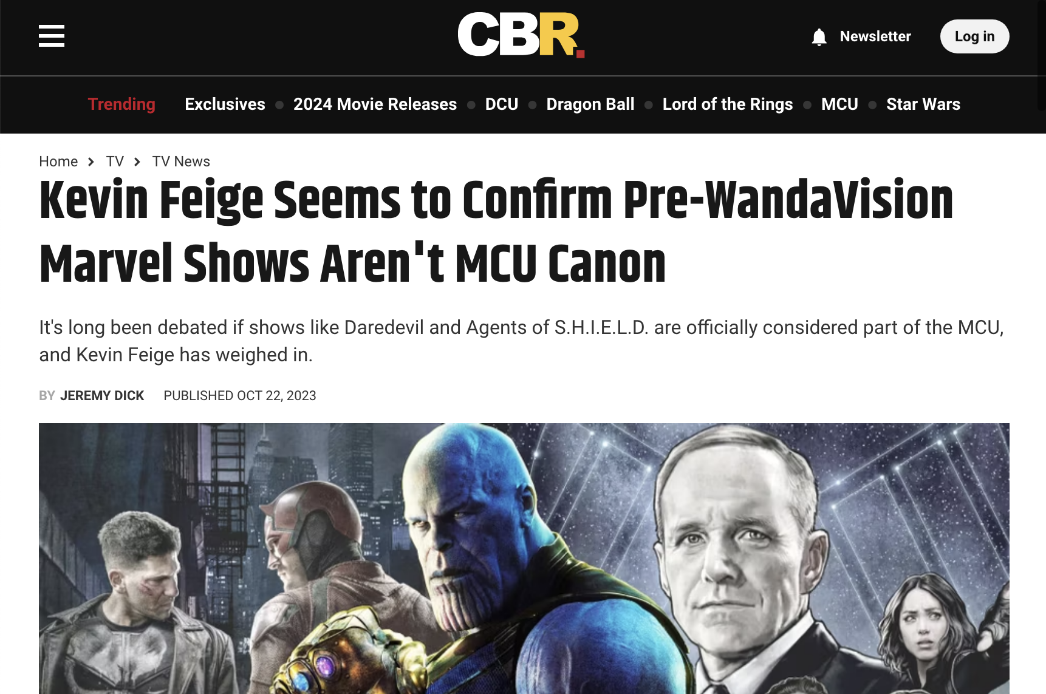
Responses
Image Source: Dick, J. (2023, October 22). Kevin Feige Seems to Confirm Pre-WandaVision Marvel Shows Aren’t MCU Canon. CBR. https://www.cbr.com/kevin-feige-past-marvel-shows-mcu-canon/

Slide 6
“Canonical” is interpreted as “shattered canon,” “non-canon,” and not being “MCU canon”…
Is this indicative of differing definitions of “canon”?

Slide 7
Overview
Historicizing “canon”
Expanding the definition in response to complicating factors in our current media landscape
a media work—or information related to it—that (a) originates from an authorized, authorial, or acquired source, (b) aligns with narrative coherence, and (c) possesses the potential to reenter or impact the diegesis of future installments of the franchise
Case study: canonicity and the Marvel Cinematic Universe
Canon as a way to structure discussions of textual meaning
Notes:
Historicizing the term “canon”
Expanding the definition in response to complicating factors in our current media landscape
a media work—or information related to it—that (a) originates from an authorized, authorial, or acquired source, (b) aligns with narrative coherence, and (c) possesses the potential to reenter or impact the diegesis of future installments of the franchise
Case study: canonicity and the Marvel Cinematic Universe
Canon as a way to structure discussions of textual meaning

Slide 8
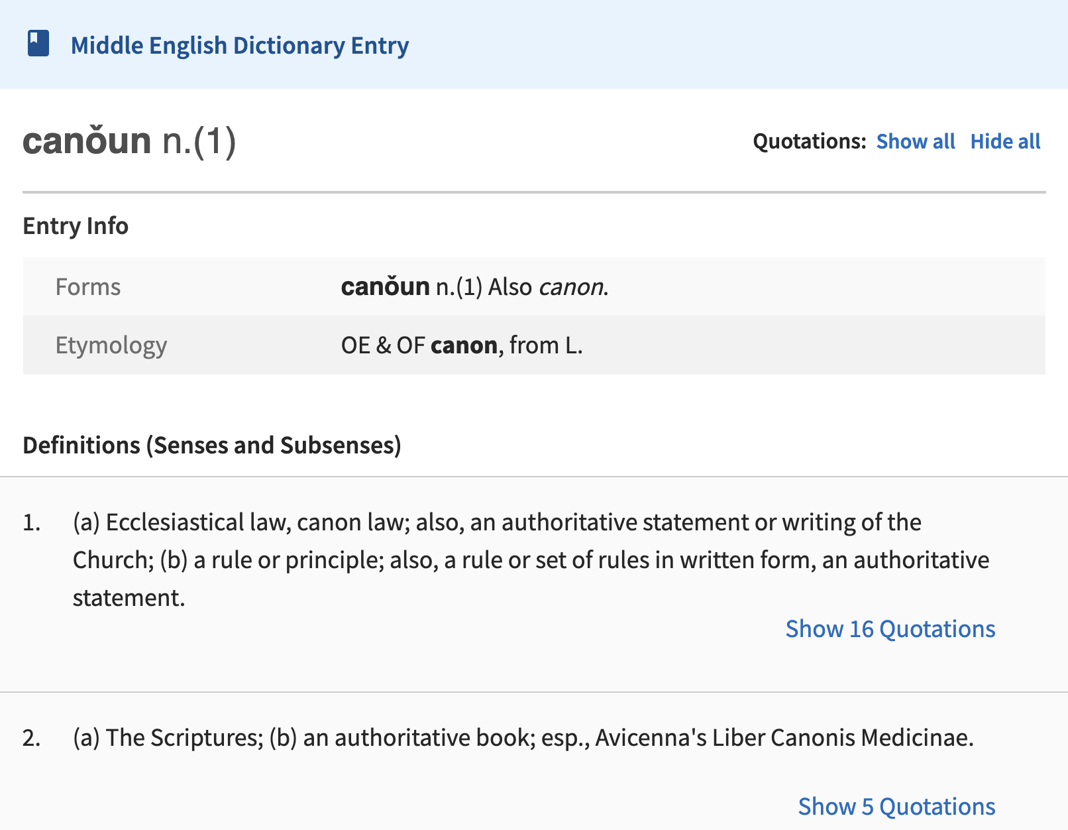
Historical Origins of “Canon”
Image Source: The University of Michigan Library. (n.d.). Canoun. Middle English Compendium. Retrieved December 18, 2023, from https://quod.lib.umich.edu/m/middle-english-dictionary/dictionary/MED6686
Historicizing “Canon”
Notes:
— “Canon” as a word has been entrenched in religious, literary, and knowledge canonization practices since before 1150 (Oxford English Dictionary, 2023).
— The University of Michigan’s Middle English Dictionary is a lexicon specific to the period of 1100-1500, and the two definitions it provides for “canǒun” or “canon” are: “(a) Ecclesiastical law, canon law; also, an authoritative statement or writing of the Church; (b) a rule or principle; also, a rule or set of rules in written form, an authoritative statement” (The University of Michigan Library, n.d.-b, n.d.-a).
— This definition both substantiates the religious connotations of the word and generalizes the application of it to an exertion of authority.

Slide 9
“Canon” in Academia
More broadly, creating a “canon” of scholarship and theory
Publications like Canonical Texts in Media Research: Are There Any? Should There Be? How About These? (Katz et al., 2003)
Within fields that study media, a “canon” of texts studied
“Using the examples of The Wire, Breaking Bad, and Mad Men, all of which have been hailed by critics as the greatest television series in the medium’s history, I discuss how we can enter into medium-specific debates over value without re-creating a canon or exclusionary critical practices” (Mittell, 2015, pp. 14–15)
Historicizing “Canon”
Notes:
Academic
Probably the sense of the word we hear most in the Academy
“Canon” of texts and theory
Canonic Texts in Media Research: Are There Any? Should There Be? How About These? (Katz et al., 2003)
“The Disavowal of Race in Communication Theory” — Paula Chakravartty and Sarah J. Jackson (2020, p. 215)
Media
“Canon” of texts studied
Helen Wheatley — Gothic Television (2006, pp. 1–2)
Jason Mittell — Complex TV: The Poetics of Contemporary Television Storytelling (2015, pp. 14–15)
Both lineages impact how “canon” is utilized in media contexts
Compiled lists of works
Veneration of authenticity and authority
Contented boundaries of value and prioritization

Slide 10
“Canon” Applied to Media Texts
(a) authoritative lists spanning an author or series’ work
“an authoritative list, for example, of the works of an author or group of authors” (Page & Thomas, 2011, p. 277)
“the story told by the original author” (Jamison, 2013, p. 28)
Historicizing “Canon”
Notes:
Established by Henry Jenkins in Textual Poachers that media fans develop their canon of media fandom through determinations about which texts to construct fan cultures around. This evaluative process accounts for a variety of criteria, ranging from fascination with the text itself or the cast within it, to genre and cultural competencies, to qualities considered for classical narratives and texts (Jenkins, 1992)
the definitions they are typically drawing upon are either referring to
(a) authoritative lists spanning an author or series’ work
The glossary of New Narratives: Stories and Storytelling in the Digital Age outright defines “canon” as the former, as “an authoritative list, for example, of the works of an author or group of authors,” (Page & Thomas, 2011, p. 277)
Fic: Why Fanfiction is Taking Over the World, Jamison puts forth two definitions of canon, the first of which succinctly describes canon as “the story told by the original author” (2013, p. 28)

Slide 11
“Canon” Applied to Media Texts
(b) verified information originating from authorized source material that remains in alignment with that media’s continuity
“that certain things are ‘true’ for an imaginary world (that characters, locations, and object exist, and that events have happened within that world)” (Wolf, 2013, p. 271)
“all information, everything that is ‘true’ and can be known by all audience members about a narrative” (Soller, 2019, p. 65)
Historicizing “Canon”
Notes:
(b) verified information originating from authorized source material that remains in alignment with that media’s continuity
signifies a transition from authorship to authorization, prioritizing verification and continuity
many fan studies scholars emphasize the importance of verification or authorization, employing qualifiers like “sanctioned,” “official” or “officially endorsed by the writers/producers,” “verifiable,” and “authoritative” in given definitions (Arrow, 2013, p. 328; Mittell, 2015, p. 116; Seymour, 2018, p. 338; Thomas, 2011, p. 218)
Wolf defines “canon” as “that certain things are ‘true’ for an imaginary world (that characters, locations, and object exist, and that events have happened within that world),”
Soller’s definition of canon encompasses “all information, everything that is ‘true’ and can be known by all audience members about a narrative” (Soller, 2019, p. 65; Wolf, 2013, p. 271)

Slide 12
“Canon” Applied to Media Texts
(b) verified information originating from authorized source material that remains in alignment with that media’s continuity
“the narrative core [of a transmedial franchise] is the medium fans consider canonical” (Joyce, 2018, p. 103)
“official, authorized storyline” (Jamison 2013, p. 11)
“the events presented in the media source that provided the universe, setting, and characters” (Hellekson & Busse, 2006, p. 9)
Historicizing “Canon”
Notes:
(b) verified information originating from authorized source material that remains in alignment with that media’s continuity
Stephen Joyce’s claim that the “narrative core [of a transmedial franchise] is the medium fans consider canonical,”
Jamison’s additional meaning of the word “canon” as meaning the “official, authorized storyline,”
Kristina Busse and Karen Hellekson’s definition of canon as “the events presented in the media source that provided the universe, setting, and characters” (Hellekson & Busse, 2006, p. 9; 2013, p. 11; Joyce, 2018, p. 103)

Slide 13
Complicating Factors
Shifting ownership of intellectual property resulting from notable acquisitions and mergers
Narrative destabilization of multiversal franchises
Acceleration of concurrent, fragmented production of transmedial content
Expanding the Definition
Notes:
Emerging complexities within the contemporary mediascape are not fully encapsulated or described
Conditions of our current media landscape that necessitate a new definition of canon
“Many of the discussions of “canon” within academic scholarship are situated within the 2010s; however, the current media environment is one defined by rapid shifts within entertainment industries and production cultures, and there have been several notable acquisitions and consequential decisions that have complicated canons in unprecedented ways”
Some of these factors are accounted for by William Proctor in his chapter “Canonicity” in The Routledge Companion to Imaginary Worlds, edited by Mark J. P. Wolf (Proctor, 2018)
Shifting ownership of intellectual property resulting from acquisitions and mergers
The restructuring of Star Wars canon after the Walt Disney Company’s acquisition of Lucasfilm
The cancellation of the release of Batgirl following the merger of AT&T’s WarnerMedia and Discovery Inc.
Narrative destabilization of multiversal franchises
“My proposed definition of “canon” diverges from traditional notions of continuity or a singular storyline to instead suggest an alignment with narrative coherence to account for the rise of the multiversal franchise”—i.e. DC, Doctor Who, Star Trek, Marvel, etc.
When various multiversal timelines and universes cannot be narratively reconciled with one another, “canon” becomes positioned as an assessment for coherence rather than adherence to continuity.
Concurrent, fragmented production of transmedial content—and attempts to maintain transmedial extensions
Accelerated output of franchisal shows like Star Wars, Marvel, Star Trek

Slide 14
Expanded Definition
Previous Definitions
Proposed Expansion
originating from authorized source material
remains in alignment with that media’s continuity
originating from an authorized, authorial, or acquired source
aligns with narrative coherence
possesses the potential to reenter or impact the diegesis of future installments of the franchise
Expanding the Definition

Slide 15
Canonicity and the Marvel Cinematic Universe
Case Study:

Slide 16
Marvel’s Internal Shifts
Shifting ownership of intellectual property resulting from notable acquisitions and mergers in 2019—complicating ”authority” and “authorized”
March 2019: Disney’s acquisition of 20th Century Fox and the X-Men
October 2019: Kevin Feige promoted to the role of chief creative officer of Marvel Entertainment
December 2019: Marvel Television division integrated into Marvel Studios
Case Study: Canonicity and the Marvel Cinematic Universe
Notes:
Discussions of Canonicity within the MCU need to encompass…
Rapid internal shifts in 2019
Disney’s acquisition of 20th Century Fox and the X-Men — March 2019
Kevin Feige promoted to the role of chief creative officer of Marvel Entertainment — October 15th, 2019
Marvel Television division integrated into Marvel Studios — December 2019
originating from an authorized, authorial, or acquired source

Slide 17
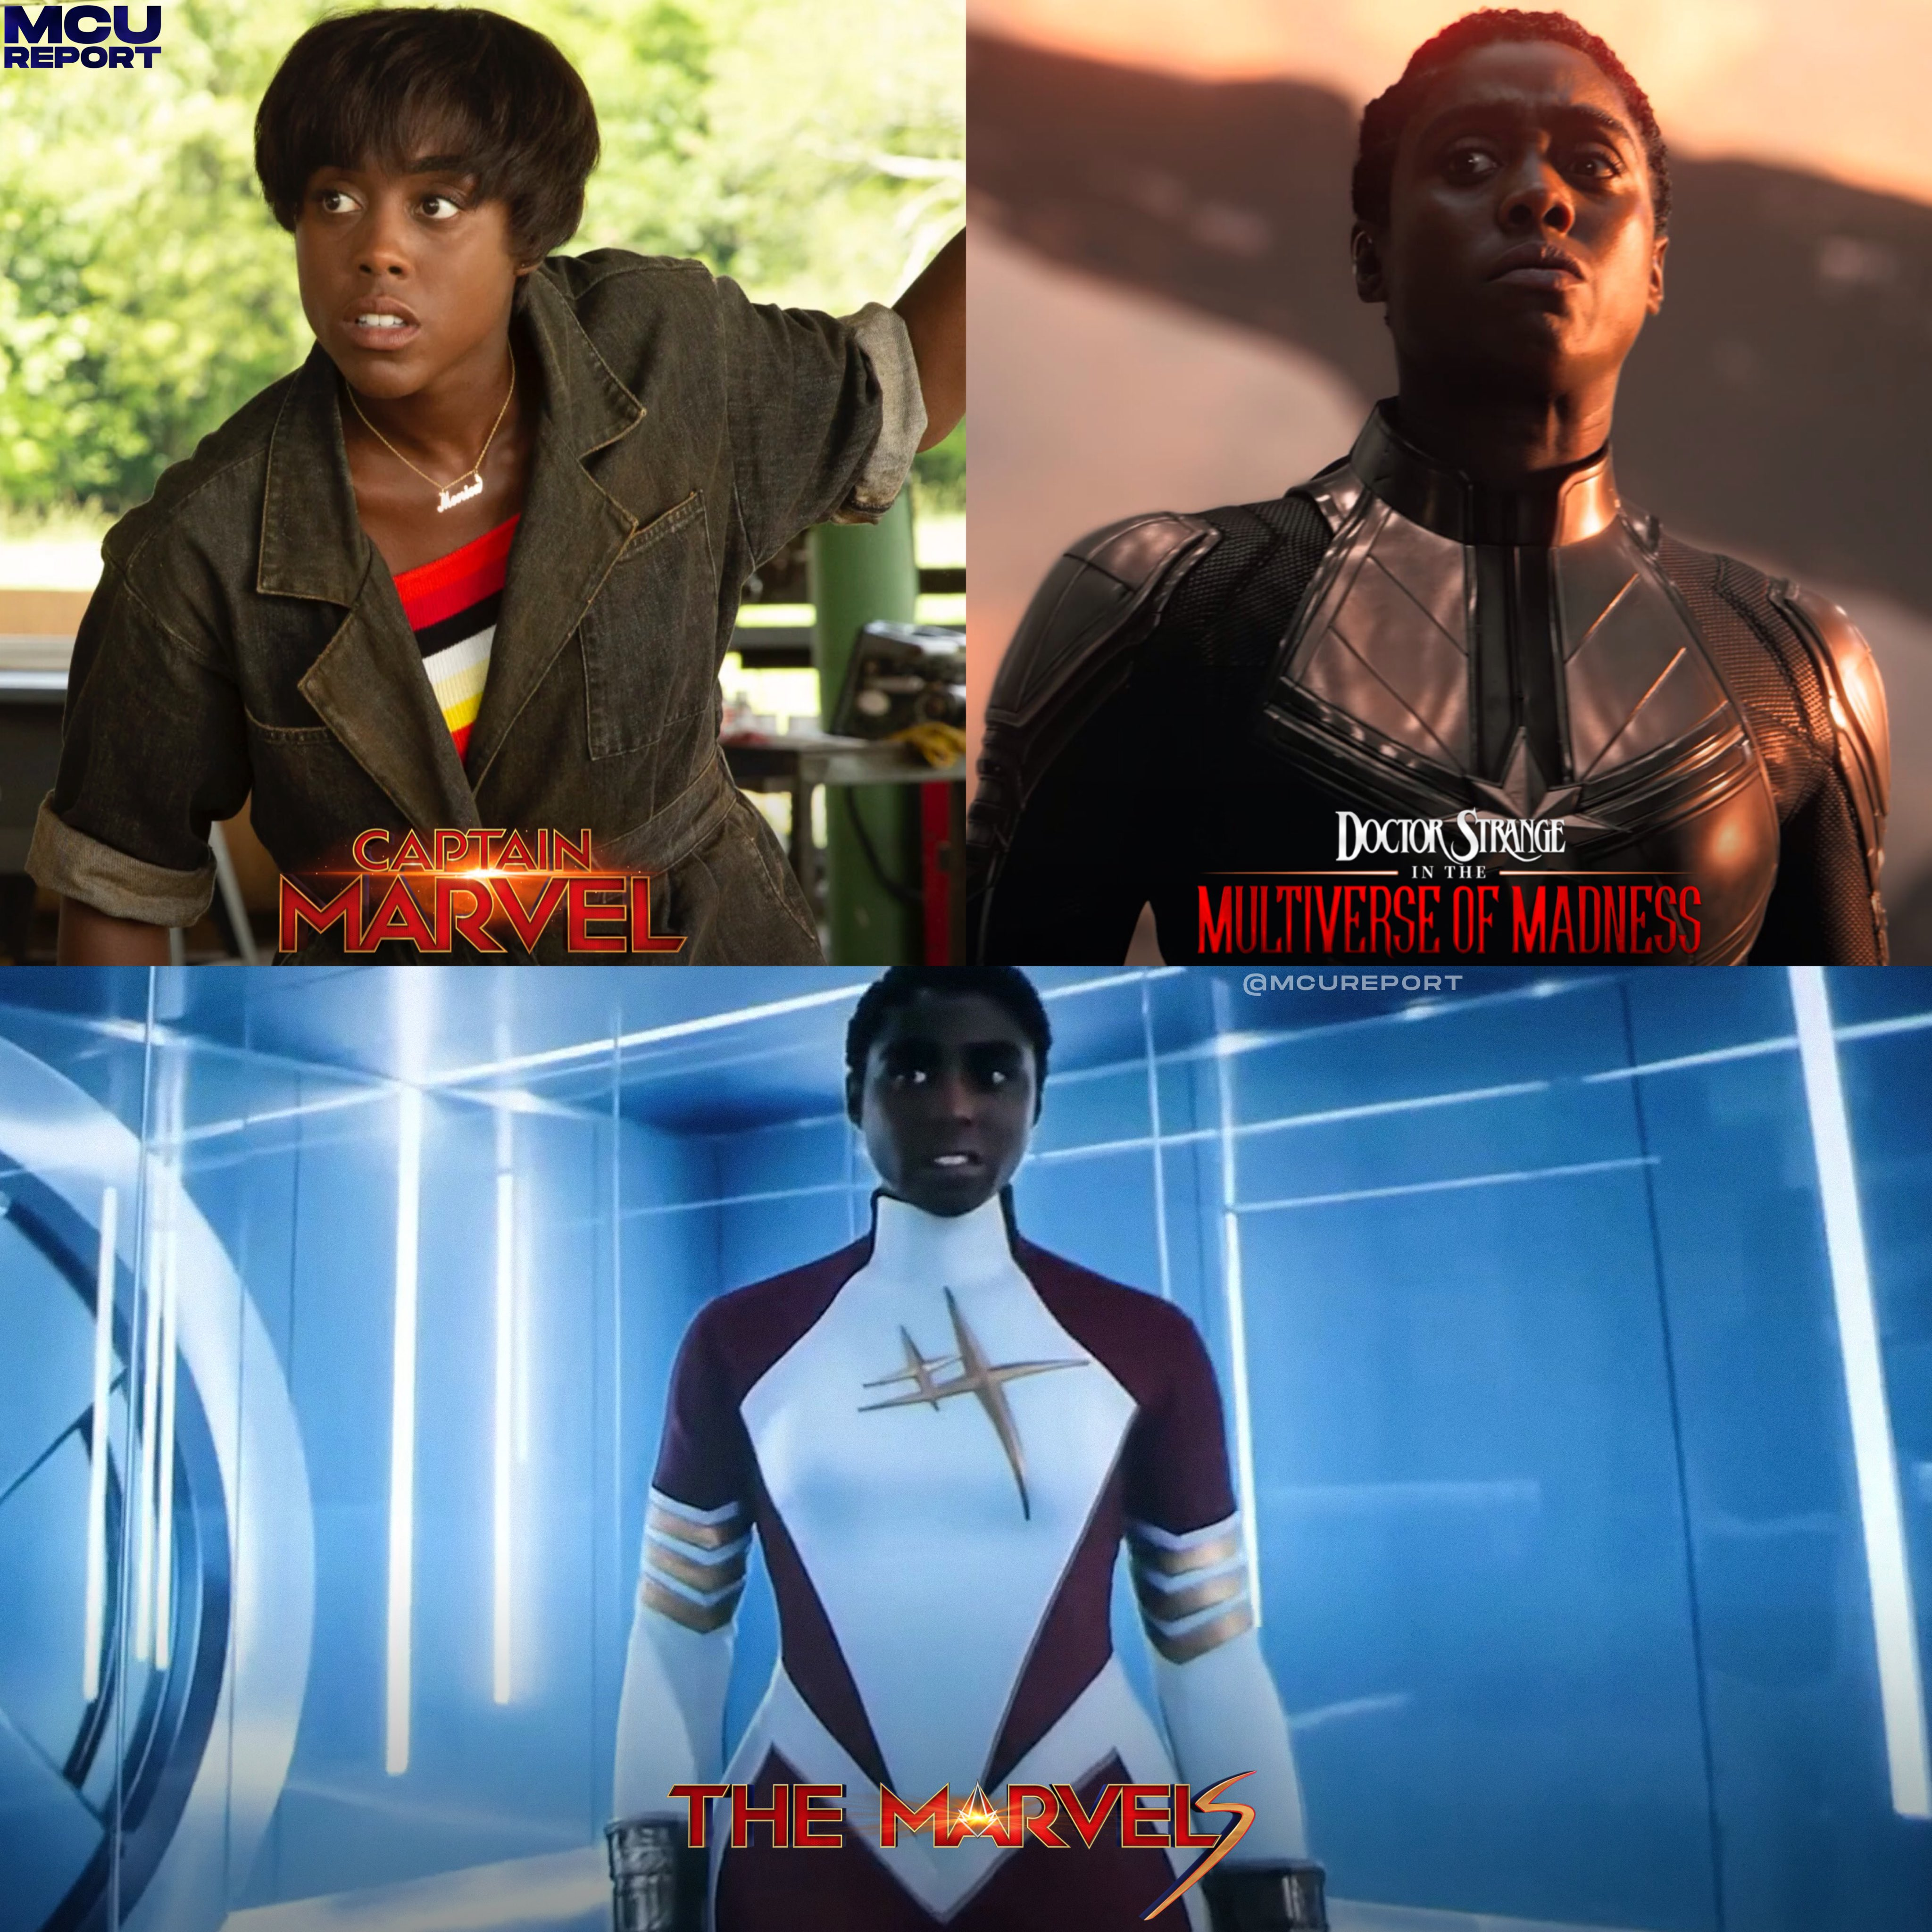
Multiversal Narratives
“Canon” as structure for the narrative destabilization of multiversal franchises
The Multiverse Saga (Phases Four, Five, and Six)
Lashana Lynch’s portrayal of three different characters
What If…? show: “The events of What If…? are canon. It’s part of the MCU multiverse. The multiverse is here.” (Skrebels, 2021)
Image Source: MCU Report [@MCUReport]. (2023, November 18). Lashana Lynch has now portrayed Maria Rambeau in 3 different realities #TheMarvels https://t.co/Bh1I9gDMfK [Tweet]. Twitter. https://twitter.com/MCUReport/status/1725979318742888823
Case Study: Canonicity and the Marvel Cinematic Universe
Notes:
Complicating traditional notions of “continuity”—instead aligns with narrative coherence
Currently in the middle of phase five of the Marvel Cinematic Universe; the first three phases belong to the “Infinity Saga,” and Phases Four through Six are attributed to the “Multiverse Saga”
When a franchise embraces multiversal possibilities, it is no longer constrained by traditional production logics; studios can engage a singular actor in a variety of roles, as demonstrated by the fact that Lashana Lynch is credited as three different characters within Marvel movies over four years: Maria Rambeau in Captain Marvel (2019), Captain Marvel in Doctor Strange in the Multiverse of Madness (2022), and Binary in The Marvels (2023) (IMDB, n.d.)
“What If” episodes are canon
The “What If?” approach to transmedia, as Mittell classifies it, “poses hypothetical possibilities rather than canonical certainties” (2015, pp. 314–315)
AC Bradley, the head writer of What If…?, declares the multiversal episodes as canonical, “The events of What If…? are canon. It’s part of the MCU multiverse. The multiverse is here” (Skrebels, 2021)

Slide 18
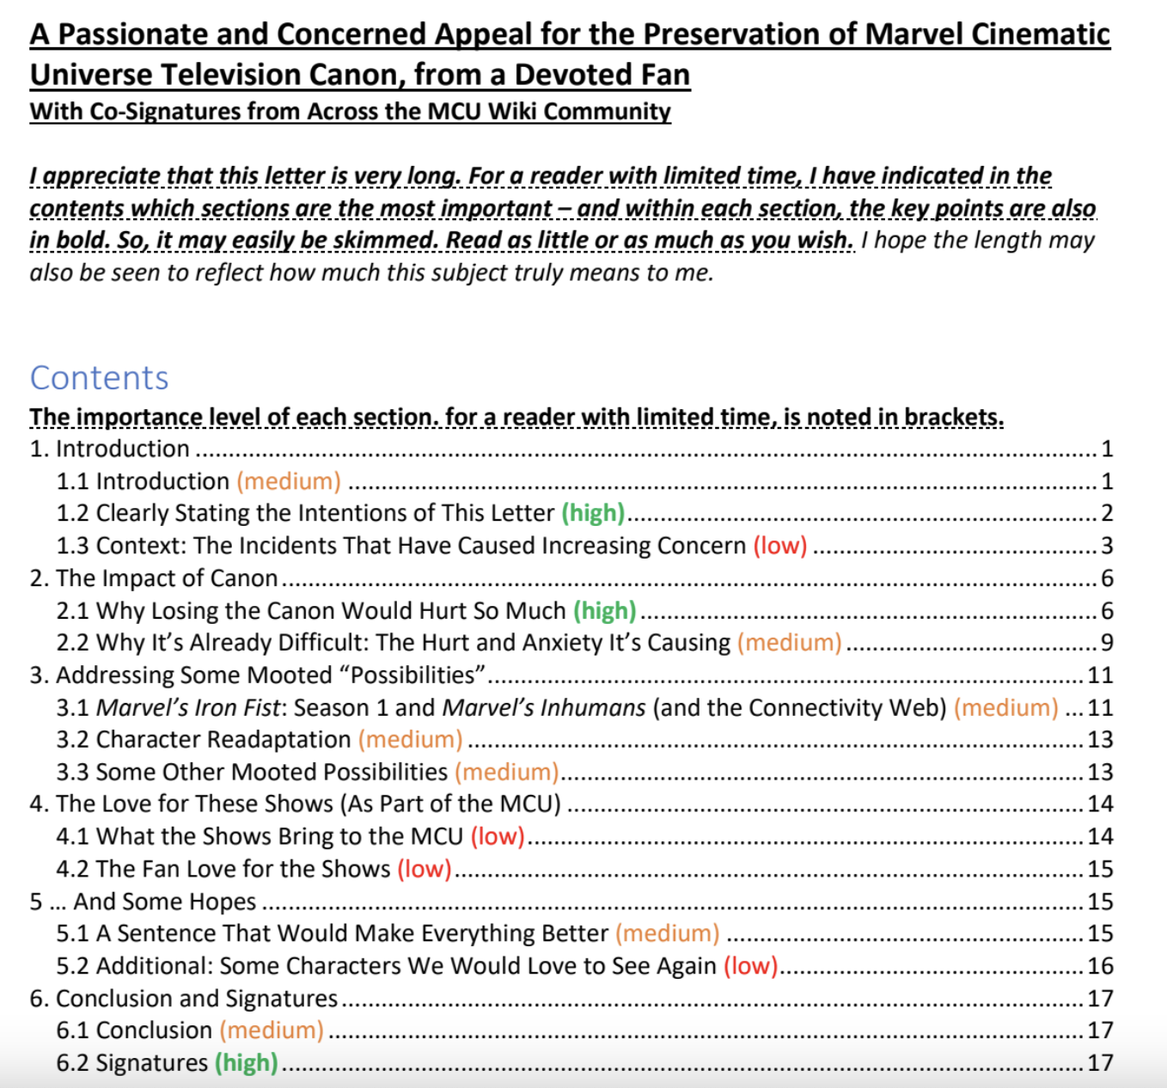
Discussions About “Canon”
Virtually directed to @MarvelStudios @Kevfeige on Twitter
Physical copies were reportedly delivered by post to Kevin Feige, Louis D’Esposito, and Victoria
Co-signed by 116 other MCU Wiki users
Image Source: A Passionate and Concerned Appeal for the Preservation of Marvel Cinematic Universe Television Canon, from a Devoted Fan With Co—Signatures from Across the MCU Wiki Community. Dropbox. https://www.dropbox.com/s/16zxkd8fgjjcnie/Letter%20to%20Marvel%20Studios.pdf?dl=0
Case Study: Canonicity and the Marvel Cinematic Universe
Notes:
in addition to providing a framework for discussion and the construction of cultural hierarchies, “canon” has also been a way for fans to advocate for recognition of the works that are important to them in a way that is legible to franchise producers
possesses the potential to reenter or impact the diegesis of future installments of the franchise

Slide 19
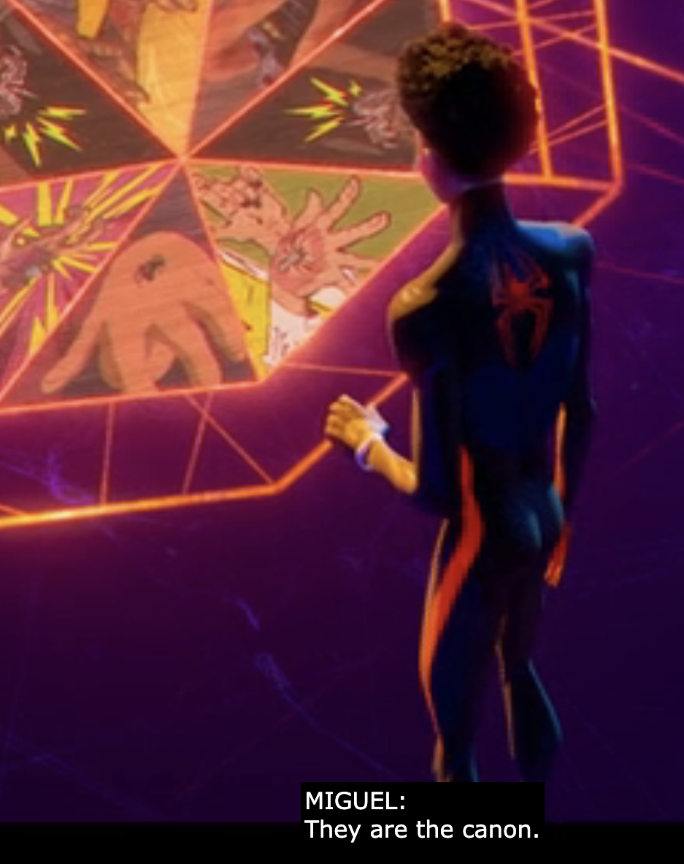
Formalizing the Term
In Spider-Man: Across the Spider-Verse (2023), Miguel O’Hara uses “canon” and “canon events”
“Canon events” emerged after test audiences were confused by the previous terminology of “convergence events” (Kuo, 2023)
Image Source: Thompson, J. K., Powers, K., & Joaquim, D. S. (Directors). (2023, June 2). Spider-Man: Across the Spider-Verse. Sony Pictures Entertainment.
Case Study: Canonicity and the Marvel Cinematic Universe
Notes:
in addition to providing a framework for discussion and the construction of cultural hierarchies, “canon” has also been a way for fans to advocate for recognition of the works that are important to them in a way that is legible to franchise producers
remiss to overlook the inclusion of the term “canon event” within Spider-Man: Across the Spider-Verse (2023)
While this film is not produced by Marvel Studios, it does indirectly demonstrate intersections:
Donald Glover makes a brief, live-action cameo as the Prowler in Spider-Man: Across the Spider-Verse (ATSV), noteworthy given his previous credit as Aaron Davis in Spider-Man: Homecoming (2017)
live-action scenes from The Amazing Spider-Man 2 (2014) and Spider-Man (2002)
projected during Miguel O’Hara’s musing about the importance of “canon events” to maintaining the structural the Spider-Verse
Miguel O’Hara’s definition of “canon events”: “chapters that are a part of every spider’s story every time […] connections that bind our lives together. And those connections can be broken.”
Implies disrupting these canon events could result in losing everything
Miguel also says: “How the story is supposed to go” In this instance, the word “canon” was specifically selected to clarify audiences’ understandings of what these convergence points represent
According to Kemp Powers, one of the directors of Across the Spider-Verse, the team had originally written them as “convergence events,” but early focus groups were confused by the phrase, so they settled upon “canon event” instead (Kuo, 2023)

Slide 20
Canon Structuring Discussions of Textual Meaning
“Canon” has come to structure the meaning of a text—and one’s positionality determines how it is applied
Indicator of importance and can communicate potential storytelling trajectories for audiences to anticipate—and economically invest in
Decanonized texts are demoted within cultural hierarchies
“Canon” determines limitations for meaning-making and narrative possibility
Conclusion
Notes:
The term has historically been employed within conversations about authorial intent, official authorization, or continuity—and, while it remains entangled within these discussions, it has come to structure the meaning of a text, and one’s positionality determines how it is applied
For Kevin Feige, the word “canon” is one among many that he can leverage in his role as chief creative officer and president of Marvel Studios to elevate films, television shows, or other sources that audiences might be prone to overlook. Like Marvel’s well-known post-credit sequences, it can serve as an indicator of importance and communicate potential storytelling trajectories for fans to anticipate.
Canon = a way to indicate narrative importance to generate economic returns
Discussed by William Proctor (2018). Canonicity. In M. J. P. Wolf (Ed.), The Routledge companion to imaginary worlds (pp. 236–245). Routledge, Taylor & Francis Group.
Consequentially, decanonized texts are demoted within cultural hierarchies, and fans who once thoroughly invested in those stories can feel devalued and devest enthusiasm from the franchise.

Slide 21
a media work—or information related to it—that (a) originates from an authorized, authorial, or acquired source, (b) aligns with narrative coherence, and (c) possesses the potential to reenter or impact the diegesis of future installments of the franchise
Expanded definition of “canon”:

